Slide 1
Parallel and Distributed Computing
Dr. Hammad Afzal
Military College of Signals
National University of Sciences and Technology, Pakistan
Spring, 2011
hammad.afzal@mcs.edu.pk

Slide 2
Chapter 4
Inter-process Communications
Socket Programming

Slide 3
Review ~ Distributed Systems
DS: Autonomous computers that work together, giving the appearance of a single coherent system
Easy to integrate different applications on different machines into a single system
Middleware ~ Additional software layer over operating system, hides heterogeneity and distributed nature, single system view, allows for a variety of distribution models

Slide 4
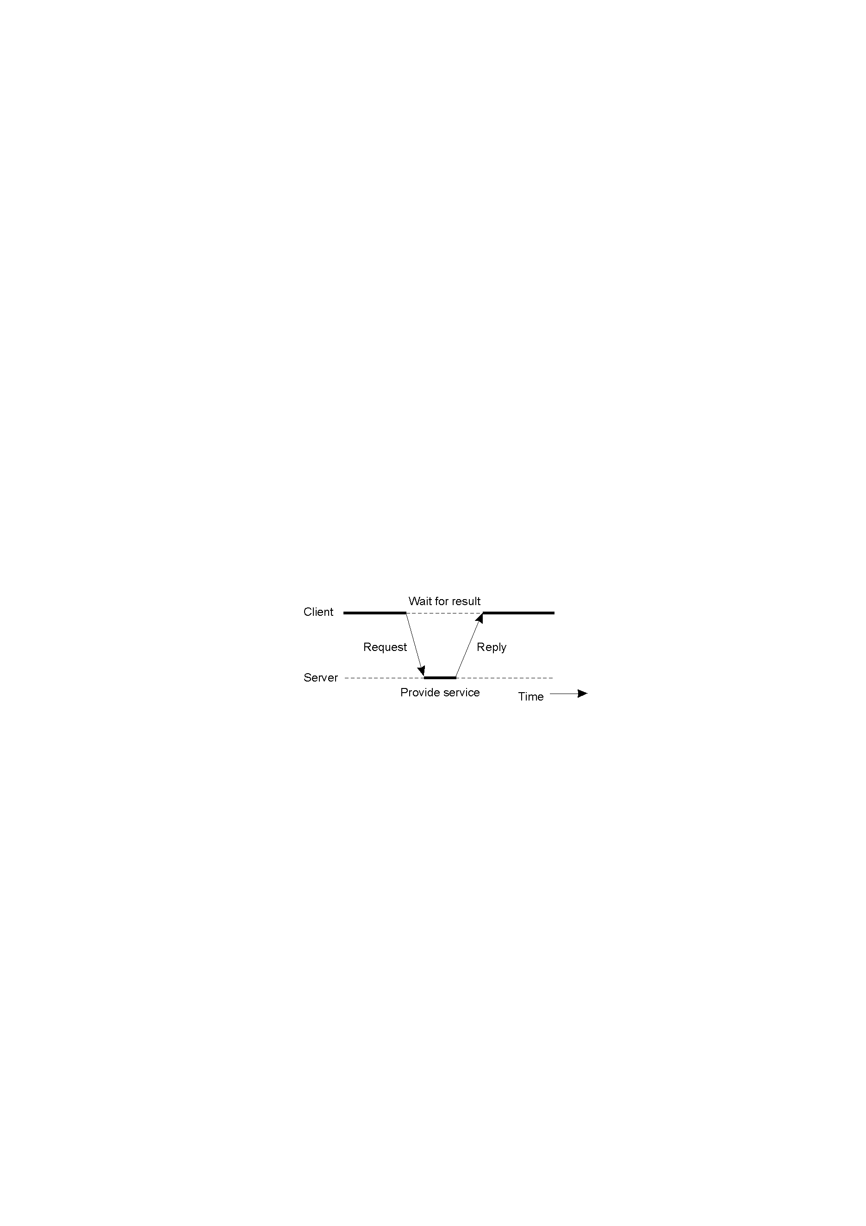
Review ~ Clients and Servers
Participants are divided into
Servers: implementing a specific service
Clients: requesting a service from a server by sending it a request and subsequent waiting for the server’s reply
Distributed across different machines
Follow a request-reply

Slide 5
Inter-process communication
The “heart” of every distributed system
Question: how do processes on different machines exchange information?

Slide 6
Characteristics of Inter-process communication
Message communication between processes is supported by two operations
Send
Receive
Send and receive synchronize

Slide 7
Characteristics of Inter-process communication
Queue associated with each message destination.
Sending process cause messages to be added to remote queues
Receiving process removes message from local queues.

Slide 8
Characteristics of Inter-process communication
Synchronous
Send and receive synchronize after each message.
Both send & receive are blocking in synchronous communication
Asynchronous
non-blocking send & blocking or non-blocking receive operation in asynchronous communication
Blocking receive in multi-thread environment is not a problem.

Slide 9
Characteristics of Inter-process communication
Message Destination
A local port within a computer specified as an integer.
A port has exactly 1 receiver but can have many senders
Processes may use multiple ports from which to receive messages
Location Transparency
If a client uses a fixed IP address to refer to a service, then that service must always run on the same computer for its address to remain valid.
That’s why: Client should not use the fixed internet address for communication, but use domain names. Refer to services by names.

Slide 10
Characteristics of Inter-process communication
Reliability
Is defined in terms of validity and integrity
Validity
Reliable if packets are guaranteed to be delivered, despite a reasonable number of packets being dropped or lost
Unreliable if …
Integrity
Messages must arrive uncorrupted and without duplication.
Ordering
Messages be delivered in sender’s order.
Regarded as failure by the applications if messages are not in order.

Slide 11
A review of Internet Model
Application Layer
Transport Layer
Network Layer
Data Link Layer

Slide 12
Internet Protocol (IP)
Datagram (packet) protocol
Unreliable service
Lost of dropped/discarded packages
Out of order delivery
Duplicate arrival
Delay
Host-to-host delivery
(not application-to-application)
IP takes packets from one host to another host.
Notes:
IP provides an unreliable service (i.e., best effort delivery). This means that the network makes no guarantees about the packet and none, some, or all of the following may apply:
data corruption
out-of-order delivery (Given packet A is sent before packet B, packet B can arrive before packet A.)
duplicate arrival
lost or dropped/discarded packages
Data from an upper layer protocol is encapsulated inside one or more packets/datagrams (the terms are basically synonymous in IP). No circuit setup is needed before a host tries to send packets to a host it has previously not communicated with (this is the point of a packet-switched network), thus IP (Internet protocol) is a connectionless protocol. This is quite unlike Public Switched Telephone Networks that require the setup of a circuit before a phone call may go through (a connection-oriented protocol).
Host-to-host delivery means that IP takes packets from one host to another host.
Datagram service analogy to the post office.

Slide 13



IP Address
32-bit identifier
Dotted-quad: 192.118.56.25
www.vitalfact.net -> 167.208.101.28
192.18.22.13
209.134.16.123
Notes:
The Internet Protocol (IP) is the method or protocol by which data is sent from one computer to another on the Internet.
Each computer (known as a host) on the Internet has at least one IP address that uniquely identifies it from all other computers on the Internet.
Packets: When you send or receive data (for example, an e-mail note or a Web page), the message gets divided into little chunks called packets. Each of these packets contains both the sender's Internet address and the receiver's address. Any packet is sent first to a gateway computer that understands a small part of the Internet. The gateway computer reads the destination address and forwards the packet to an adjacent gateway that in turn reads the destination address and so forth across the Internet until one gateway recognizes the packet as belonging to a computer within its immediate neighborhood or domain. That gateway then forwards the packet directly to the computer whose address is specified.
Because a message is divided into a number of packets, each packet can, if necessary, be sent by a different route across the Internet. Packets can arrive in a different order than the order back in the right order they were sent in. The Internet Protocol just delivers them. It's up to another protocol, the Transmission Control Protocol (TCP) to put them in order.
IP is a connectionless protocol, which means that there is no continuing connection between the end points that are communicating. Each packet that travels through the Internet is treated as an independent unit of data without any relation to any other unit of data. (The reason the packets do get put in the right order is because of TCP, the connection-oriented protocol that keeps track of the packet sequence in a message.) In the Open Systems Interconnection (OSI) communication model, IP is in layer 3, the Networking Layer.
The most widely used version of IP today is Internet Protocol Version 4 (IPv4). However, IP Version 6 (IPv6) is also beginning to be supported. IPv6 provides for much longer addresses and therefore for the possibility of many more Internet users. IPv6 includes the capabilities of IPv4 and any server that can support IPv6 packets can also support IPv4 packets.

Slide 14
Ports
Identifying the ultimate destination
IP addresses identify hosts
Host has many applications
Ports (16-bit identifier)
Application http E-mail Telnet
Port 80 25 23
FTP
21
192.18.22.13
Notes:
Ports are analogous to phone extensions from main switchboard

Slide 15
Connection (-less) Transport Layer
Connection-oriented transportation layers
Provide operations to:
Open a connection
Close a connection
Write data into such a connection;
Read data from such a connection.
Connection-less transportation layers
Provide the ability of sending fixed length messages between distributed hosts;
These messages are referred as datagrams;

Slide 16
Transport Protocols
Transmission Control Protocol (TCP)
Connection-oriented
Reliable but slow
Data checksum
Reliable byte-stream delivery
Congestion control
User Datagram Protocol (UDP)
Connection-less
Very fast but unreliable
Data checksum
Choice of protocol depends on whether or not the application needs to retain the connection for long periods of time.

Slide 17
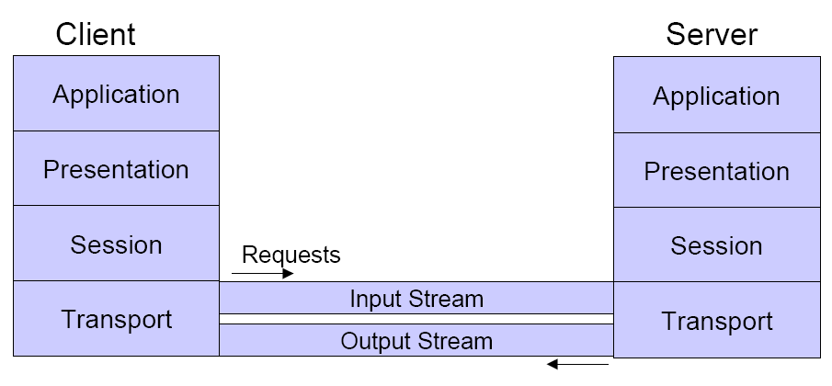
TCP – Graphical Representation

Slide 18
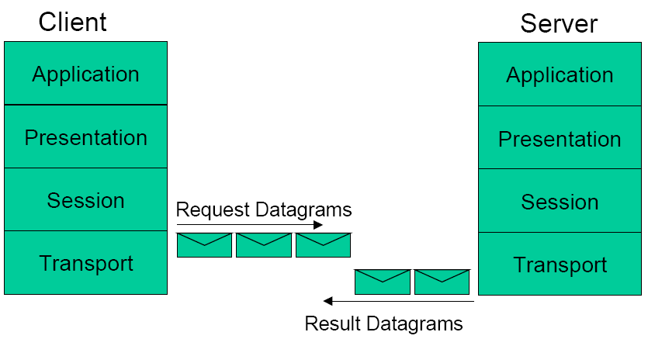
UDP Graphical Representation

Slide 19
TCP/IP Byte Transport
TCP/IP protocols transports bytes
Application protocol provides semantics
Application
Application
byte stream
byte stream
Here are some bytes. I don’t know what they mean.
I’ll pass these to the app. It knows what to do.
TCP/IP
TCP/IP
Notes:
The User Datagram Protocol (UDP)
The User Datagram Protocol (UDP) is a transport layer protocol defined for use with the IP network layer protocol. It is defined by RFC 768 written by John Postel. It provides a best-effort datagram service to an End System (IP host).
The service provided by UDP is an unreliable service that provides no guarantees for delivery and no protection from duplication (e.g. if this arises due to software errors within an Intermediate System (IS)). The simplicity of UDP reduces the overhead from using the protocol and the services may be adequate in many cases.
A computer may send UDP packets without first establishing a connection to the recipient. The computer completes the appropriate fields in the UDP header (PCI) and forwards the data together with the header for transmission by the IP network layer.
User Datagram Protocol (UDP) is one of the core protocols of the Internet protocol suite. Using UDP, programs on networked computers can send short messages sometimes known as datagrams (using Datagram Sockets) to one another. UDP is sometimes called the Universal Datagram Protocol. The protocol was designed by David P. Reed in 1980.
UDP does not guarantee reliability or ordering in the way that TCP does. Datagrams may arrive out of order, appear duplicated, or go missing without notice. Avoiding the overhead of checking whether every packet actually arrived makes UDP faster and more efficient, for applications that do not need guaranteed delivery.
Time-sensitive applications often use UDP because dropped packets are preferable to delayed packets. UDP's stateless nature is also useful for servers that answer small queries from huge numbers of clients. Unlike TCP, UDP is compatible with packet broadcast (sending to all on local network) and multicasting (send to all subscribers).

Slide 20
Socket
How does one speak to Transport Layer Protocols ? (UDP/TCP)
Sockets provides interface to TCP/IP
Generic interface for many protocols
To send or receive messages process must create a socket.
Socket is bound to an Internet address of local host & a local port.
Server binds it socket to a publicized port so that the client can send the request messages to those ports.
The receive method returns the internet address of the client which helps the server to send back the reply to the required individual.
Processes may use same socket for sending and receiving

Slide 21
Sockets in Java
Facilities for simple network programming in Java can be found in Java.net package
Main classes
Socket and ServerSocket for TCP
DatagramPacket and DatagramSocket for UDP

Slide 22
UDP Datagram communication
Some issues regarding to the UDP communication
Message Size:
receiving process specify an array of bytes for message size
underlying IP protocol allows packet lengths of up to 2¹⁶ bytes, which includes header as well as the messages.
An app requiring msgs larger than this must fragment them into chunks of that size
Notes:
Some issues regarding to the UDP communication are as follows:
Message Size: receiving process specify an array of bytes for msg size
underlying IP protocol allows packet lengths of up to 2¹⁶ bytes
An app requiring msgs larger than this must fragment them into chunks of that size
Blocking: sockets normally provide non-blocking sends & blocking receives for datagram communication. Send operation returns when it has handed the message to the underlying protocol. On arrival msg is placed at the queue at the dest socket that is bound to the desired port. Msg is collected from there by the receive operation.
Msgs are discarded at dest. If no process already has a socket bound to dest.

Slide 23
UDP Datagram communication
Blocking:
Normally provide non-blocking sends & blocking receives.
Send operation returns when it has handed the message to the underlying UDP and IP protocol.
Message is collected from there by the receive operation.
On arrival message is placed at the queue at the destination socket that is bound to the desired port.
The message can be collected from the queue by an outstanding or future invocation of receive on that socket.
If no process has socket bound at destination, packet shall be discarded.
The method receives blocks until a datagram is received, unless a timeout has been set on the socket. (Use separate threads)
Notes:
Some issues regarding to the UDP communication are as follows:
Message Size: receiving process specify an array of bytes for msg size
underlying IP protocol allows packet lengths of up to 2¹⁶ bytes
An app requiring msgs larger than this must fragment them into chunks of that size
Blocking: sockets normally provide non-blocking sends & blocking receives for datagram communication. Send operation returns when it has handed the message to the underlying protocol. On arrival msg is placed at the queue at the dest socket that is bound to the desired port. Msg is collected from there by the receive operation.
Msgs are discarded at dest. If no process already has a socket bound to dest.

Slide 24
UDP Datagram communication
Timeouts
In case sending process is crashed or data is lost
(Details from Book)
Notes:
Some issues regarding to the UDP communication are as follows:
Message Size: receiving process specify an array of bytes for msg size
underlying IP protocol allows packet lengths of up to 2¹⁶ bytes
An app requiring msgs larger than this must fragment them into chunks of that size
Blocking: sockets normally provide non-blocking sends & blocking receives for datagram communication. Send operation returns when it has handed the message to the underlying protocol. On arrival msg is placed at the queue at the dest socket that is bound to the desired port. Msg is collected from there by the receive operation.
Msgs are discarded at dest. If no process already has a socket bound to dest.

Slide 25
UDP Datagram communication
Receive from any:
receive doesn't specify an origin for msgs
Receive method returns the Internet address & local port of the sender
Its possible to connect datagram socket to a particular remote port & Internet address, in which case the socket is only able to communicate with that address
It doesn't suffer from overheads i.e.
Transmission of extra messages
Store state information (connection)

Slide 26
UDP Client
Define Socket
DatagramSocket aSocket = null;
Setting up Request
aSocket = new DatagramSocket();
byte [] m = args[0].getBytes();
InetAddress aHost = InetAddress.getByName(args[1]);
int serverPort = 6789;
DatagramPacket request = new DatagramPacket(m,args[0].length(),aHost, serverPort);
Sending and Receiving
aSocket.send(request);
byte[] buffer = new byte[1000];
DatagramPacket reply = new DatagramPacket(buffer, buffer.length);
aSocket.receive(reply);

Slide 27
UDP Server
Define Socket
DatagramSocket aSocket = null;
Setting up Request
aSocket = new DatagramSocket(6789);
byte[] buffer = new byte[1000];
Sending and Receiving
while(true)
{
DatagramPacket request = new DatagramPacket(buffer, buffer.length);
aSocket.receive(request);
DatagramPacket reply = new DatagramPacket(request.getData(),
request.getLength(), request.getAddress(), request.getPort());
aSocket.send(reply);
}

